Slide 1
The Effects of Mortality Salience on Decision Making Using a Framing Task
Samantha Nicholas & Khrys Nugent
Hanover College
PSY 462: Advanced Research
Notes:
You’ll want to change the course name to Psy 462. Or just delete that and the date.

Slide 2
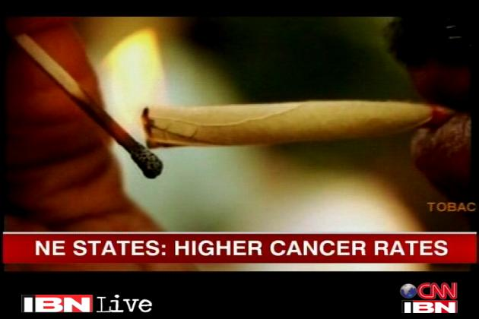
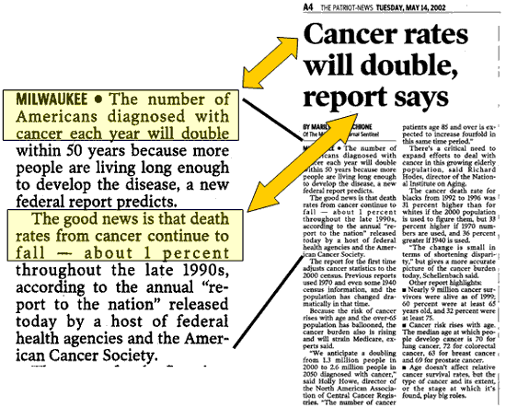
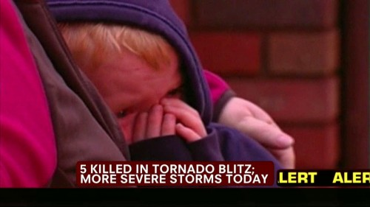

Slide 3
Mortality Salience
Mortality salience is the activation of thoughts about one’s own death.
In order to manage the negative emotions that mortality salience induces, participants:
Favor in-groups more than out-groups (Greenberg et al., 1994).
Report an increased desire to use harsh punishments for minor moral transgressions (Pyszczynski et al., 2003).

Slide 4
Asian Disease Problem
Asian Disease Problem
Imagine that the U.S. is preparing for the outbreak of an unusual Asian disease, which is expected to kill 600 people. Two alternative programs to combat the disease have been proposed, assume that the exact scientific estimates of the consequences of the programs are as follows.
1. If Program A is adopted, 200 people will be saved.
2. If Program B is adopted, there is 1/3 probability that 600 people will be saved and 2/3 probability that no people will be saved.
1. If Program C is adopted, 400 people will die.
2. If Program D is adopted, there is 1/3 probability that no people will die and 2/3 probability that 600 people will die.

Slide 5
Framing Effect
The way participants respond to such tasks are seen to be effected by:
The Framing Effect
Framing is how a scenario is worded; negative/positive.
The framing effect has found people choose more risky options in the negative frame.
Tversky & Kahneman, 1986
Cassotti et al., 2012
Notes:
I think the findings from the Arkes article and the Cassotti article contradict each other. You’ll want to think about this, and decide what to do.

Slide 6
Negative Emotions Lead to More Risk-Taking
Emotions
Participants primed with negative emotions were more likely to choose the risky option (Cassotti et al, 2012).
When primed with positive emotions, the framing task no longer had an effect.
The induction of negative affect increased people’s tendency to choose high-risk, high-payoff options (Leith and Baumeister, 1996)

Slide 7
Decision Making
Ben-Ari (2000)
Findings show that induction of mortality salience led to more risky driving among individuals who perceived driving as relevant to their self-esteem.
Hart et al. (2010)
Participants in the MS condition made more risky decisions than control participants
Notes:
What we were interested in researching, which hasn’t been studied much already, is how the induction of mortality salience effects decision-making:
The authors suggested that, when primed with thoughts of their own death ,“p eople who perceive driving as relevant to their self-esteem may overemphasize the self-relevant gains involved in driving (validating one’s sense of mastery, improving social prestige), may pay little attention to potential dangers, and then may take more risks while driving” (Ben-Ari, 2000)
Mortality salience is said to increase feelings of anxiety and therefore lead to the pursuit of positive emotions to suppress these feelings which can be done through monetary rewards (gambling).

Slide 8
Research Questions
How does mortality salience influence people’s decisions on a framing task?
1. Does the framing effect hold, increase, or diminish when people
are asked to think about their own death?
Previous research suggests the framing effect will be stronger in the mortality salience group -- because the emotions engendered by this are really negative.
2. Does preference for risky decisions increase or decrease when
people are asked to think about their own death?
Related research suggests that mortality salience should produce greater risk-taking, regardless of frame.
Notes:
Tversky and Kahneman, 1986
Related research suggests people are more likely to choose the risky option over the certain option (Hart et al.)

Slide 9
Participants
Total
148
Gender
Male: 26 %
Female: 74 %
Ethnicity
Caucasian: 82%
African-American: 5%
Hispanic: 3%
Asian: 3%
Other: 7%
Average Age: 28

Slide 10
Procedure
Survey
Survey was advertised on well known research website Psychological Research on the Net.
Links to the survey were also provided on Facebook and LinkedIn.
Informed Consent
Demographics
Age
Gender
Race

Slide 11
Procedure
Participants were randomly placed in a condition and a frame.
Mortality Salience Condition or the Control/Hard Exam Condition.
Mortality Salience Questionnaire
“What color would you like your casket to be?”
Hard Exam Questionnaire
“How much did you study for this hard exam?”
Negative Frame or Positive Frame
Negative Frame
"If Program C is adopted, 400 people will die"
Positive Frame
"If Program A is adopted, 200 people will be saved”

Slide 12
Procedure
Asian Disease Problem
Imagine that the U.S. is preparing for the outbreak of an unusual Asian disease, which is expected to kill 600 people. Two alternative programs to combat the disease have been proposed, assume that the exact scientific estimates of the consequences of the programs are as follows.
1. If Program A is adopted, 200 people will be saved.
2. If Program B is adopted, there is 1/3 probability that 600 people will be saved and 2/3 probability that no people will be saved.
1. If Program C is adopted, 400 people will die.
2. If Program D is adopted, there is 1/3 probability that no people will die and 2/3 probability that 600 people will die.
Debriefing

Slide 13
Results
X²(1)= 6.42, p=.01
X²=.02, p = .88
X²(1) = 1.78, p=.18
X²=2.99, p = .08

Slide 14
Discussion
As predicted, we got the framing effect in the hard exam condition.
Contrary to predictions, we did not get the framing effect in the mortality salience condition.
Contrary to predictions, the mortality salience group was not more risk-seeking than the hard exam group
In fact, in the negative frame, they were more risk-averse.
Why this might be:
We used a different task than studies done in the past: saving lives vs. doing something for oneself (gambling or driving).

Slide 15
Limitations
Some people placed in the Hard Exam Condition had not been in school for a long time or had not finished school
MS prime may also prime fear of loss for family, which may lead people to being risk-averse.
Had a lot more female participants than males
Studies have shown that males tend to partake in more risky behaviors than females (Gil, 2005; Pawlowski, Atwal, & Dunbar, 2008; and Leijenhorst, Westenberg, & Crone, 2008)

Slide 16
Any Questions?

